Slide 1
Four 2 Win
CS 125 |Spring 2026

Slide 2
Project Overview
The project simulates a game of Connect 4 using C language.
Motivation:
Applying learned skills to something fun
Get more comfortable with C with a known topic
Be able to share game/code with others
Used tools like file I/O, arrays, structs, and functions in the code
2

Slide 3
Challenges We Faced and How We Fixed Them
Coding:
We had some trouble troubleshooting.
Building 2D arrays is CHALLENGING!
TONS of functions => occasionally getting tangled, messy in main file
Team:
Some meetings had to be cancelled due to other commitments.
Solutions:
Learned new topics/techniques not taught in class from websites like StackExchange
Communication/Working with In-Class time
3

Slide 4
How did use AI to Help?
We used AI to make the logo for our project.
We also used AI for some troubleshooting/debugging, but not all.
We used it to help guide us to some ideas we had.
4

Slide 5
DEMOOOOOO
Our main game file is 15 lines long!
5

Slide 6
Conclusion
We had some fun coding this and seeing it come to life.
Learned new techniques and tools
Worked through other commitments, schedules, and challenges
Will likely use the project code to play with friends because why not?
Sources
C - Stack Exchange
Friends with coding knowledge
Google Gemini
6

Slide 7
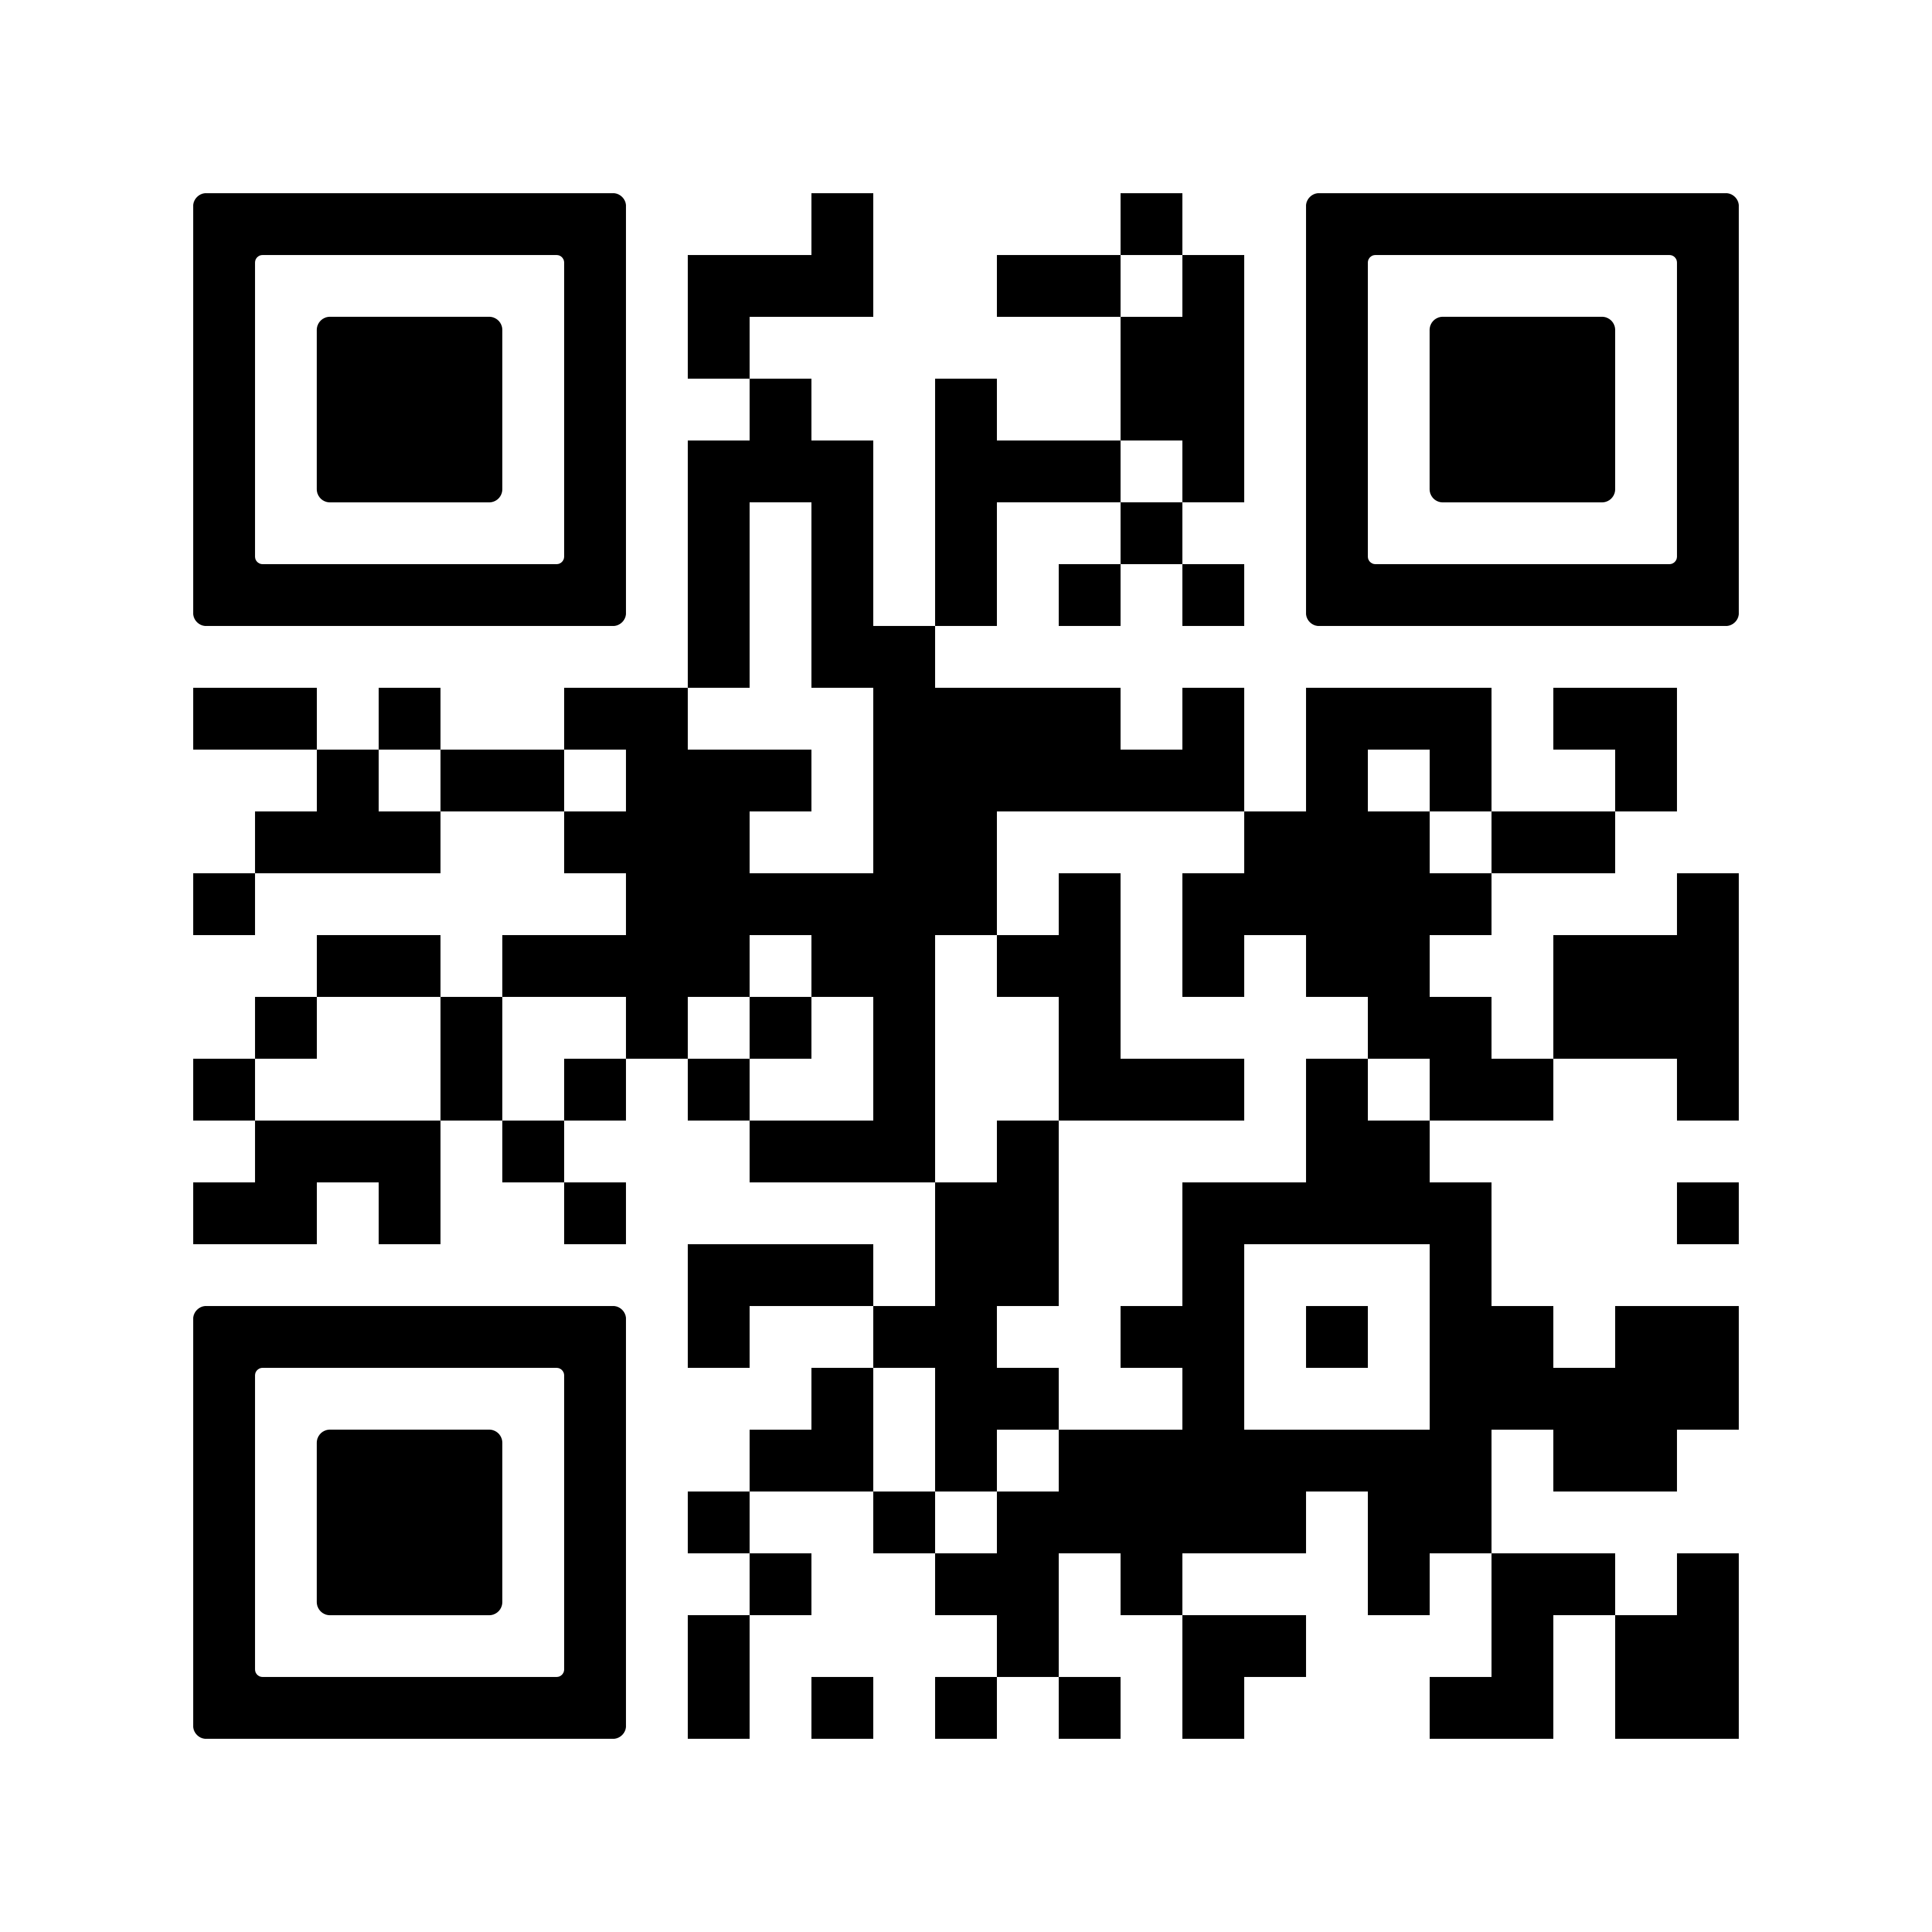
Any Questions?
Wanna try it out?
Our public GitHub!
7

